Slide 1
A data assimilation approach to quantify uncertainty for estimates of biomass stocks and changes in Amazon forests
Paul Duffy
Michael Keller
Doug Morton

Slide 2
Outline
Consider the generation of data products based on inventory and lidar data
Initial results for the combination of information from these data products
Discuss next steps for additional uncertainty quantification

Slide 3
Approach
Generate low level Aboveground Carbon Density (Mg C ha⁻¹) data products based on both inventory and lidar data
Implement a statistical data assimilation algorithm to generate spatially explicit estimates of higher order data products with uncertainty

Slide 4
Approach
Use a Hierarchical modeling frame work
  Data models (lidar and inventory)
  Process models (Land Use, Topography)
  Parameter models (measurement error, spatial range, etc.)

Slide 5
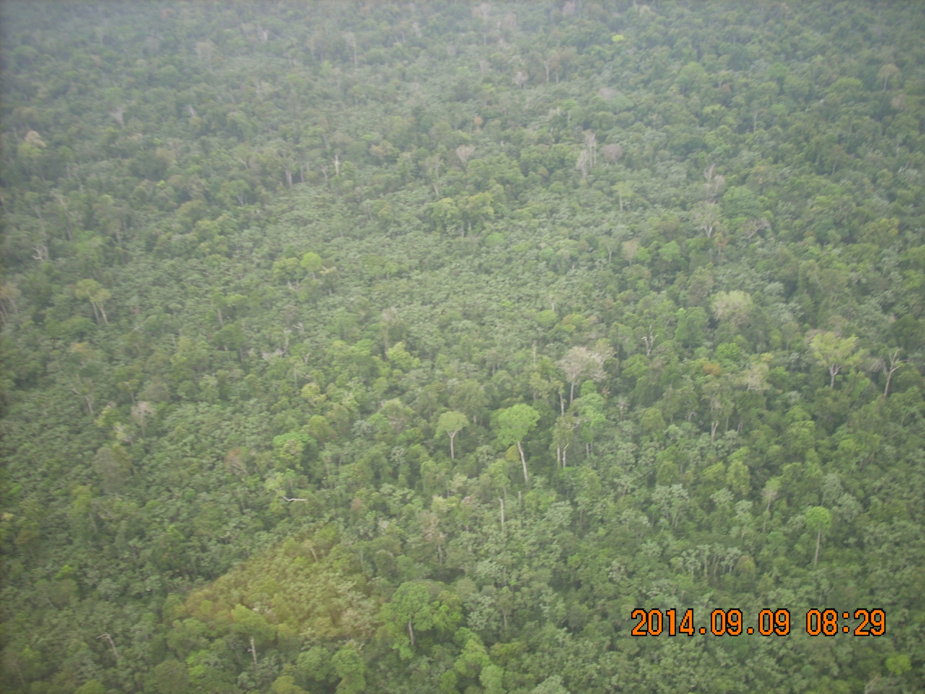
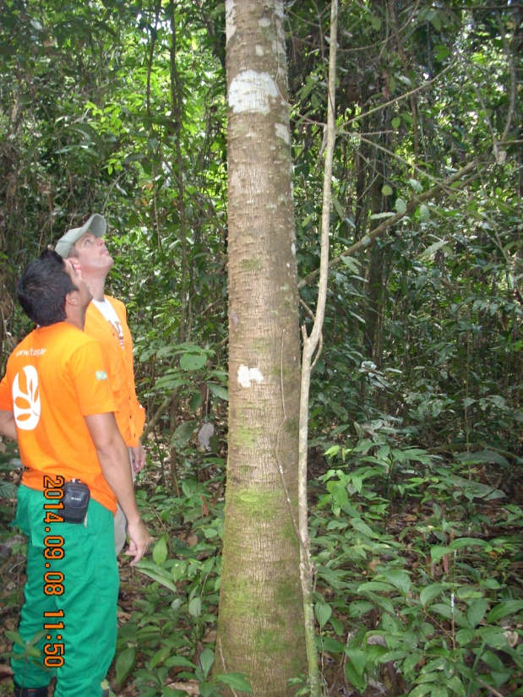
Inventory Data
22 transects of 20x500m were measured
Biomass for each tree was estimated
E.g. 0.051*specific density*DBH^2*Total height (Chave 2005)

Slide 6
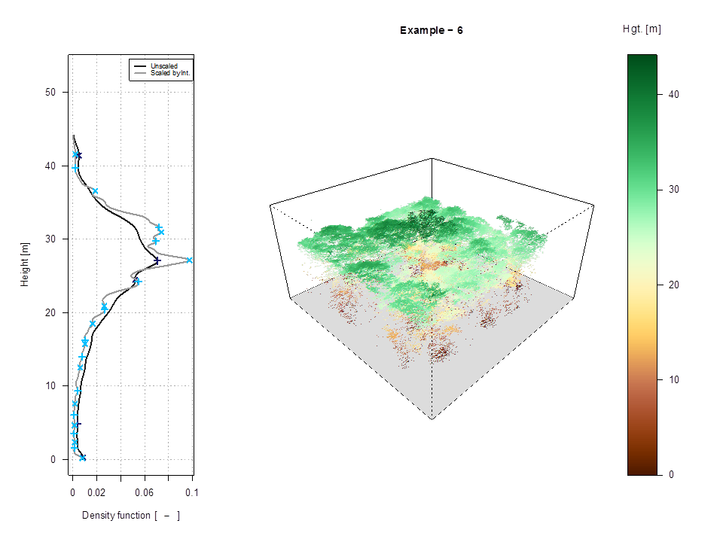
Lidar Data
The variation within the corresponding CHM pixel is depicted by this distribution

Slide 7
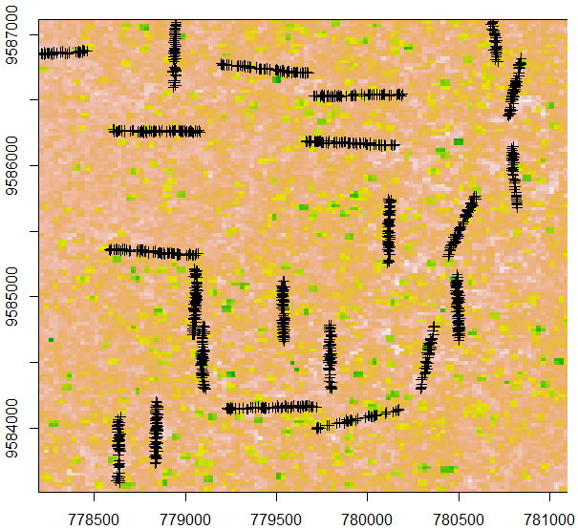
Lidar P100 Returns Heights with Transects

Slide 8
Data Model: Measurement Error
Lidar and inventory are considered as distinct and uncertain measurements of the unobservable ACD
Specific sources of uncertainty can be due to:
  Sampling error, allometry models
  Lidar data acquisition strategy
  Spatial resolution (25m², 50m², etc.)

Slide 9
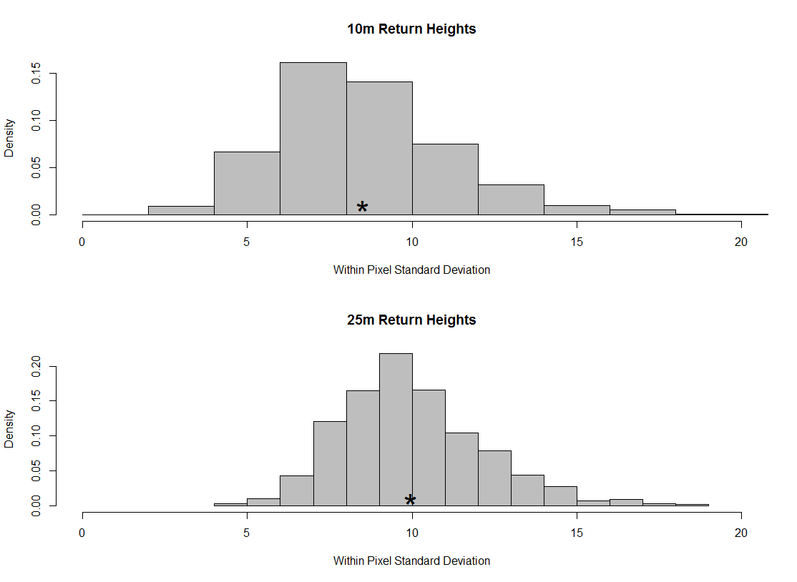
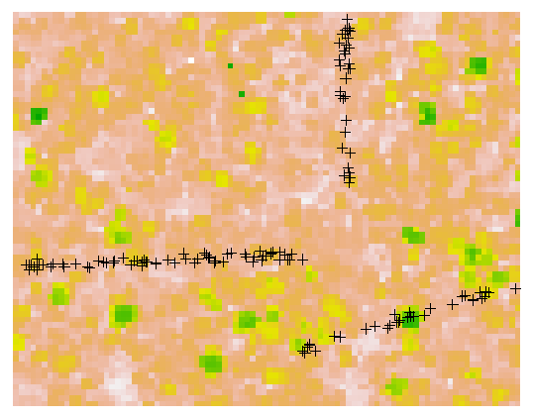
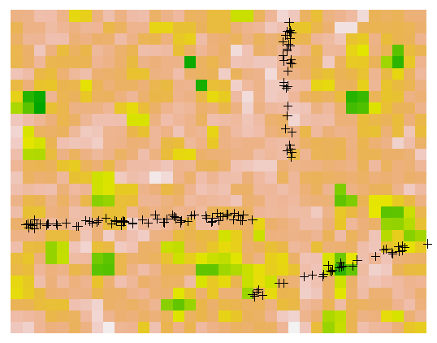
Lidar Within Pixel SD for Returns Heights

Slide 10
Process Model Development
At spatial scales corresponding to the size of the domain for our analysis, land use is the strongest driver
Currently, the deterministic component of our process model is just a mean term
We will use satellite imagery to build land cover explanatory variables for potential use in the process model

Slide 11
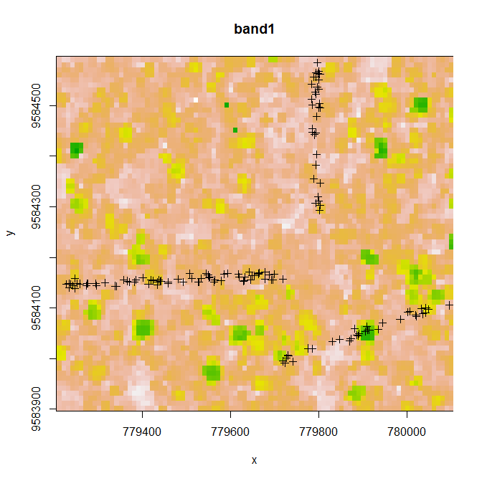
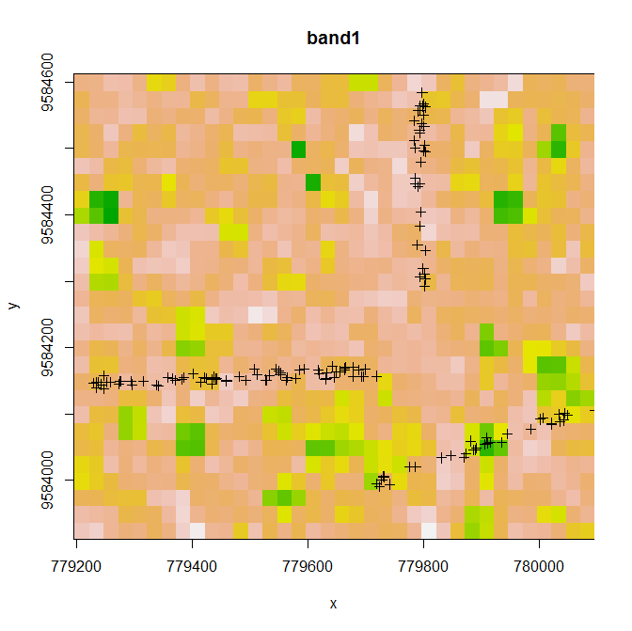
Lidar Variograms for P100 Returns Heights

Slide 12
Assimilation for High–Level Data Products
Preliminary implementation of assimilation algorithms
Quantitative measures of uncertainty associated with high-level data products can be the endpoint for characterization

Slide 13
Assimilation for a test Subregion

Slide 14
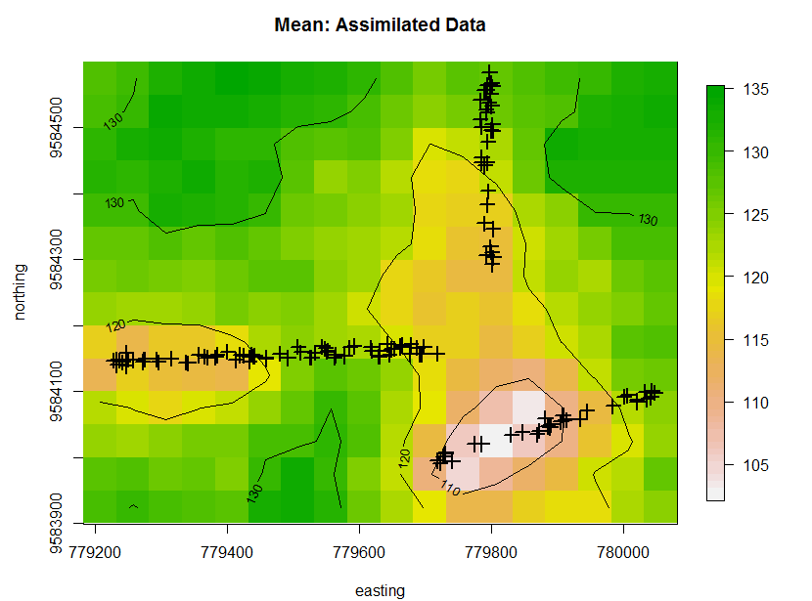
Mean of
Assimilated ACD Data Product (Mg C ha⁻¹)

Slide 15
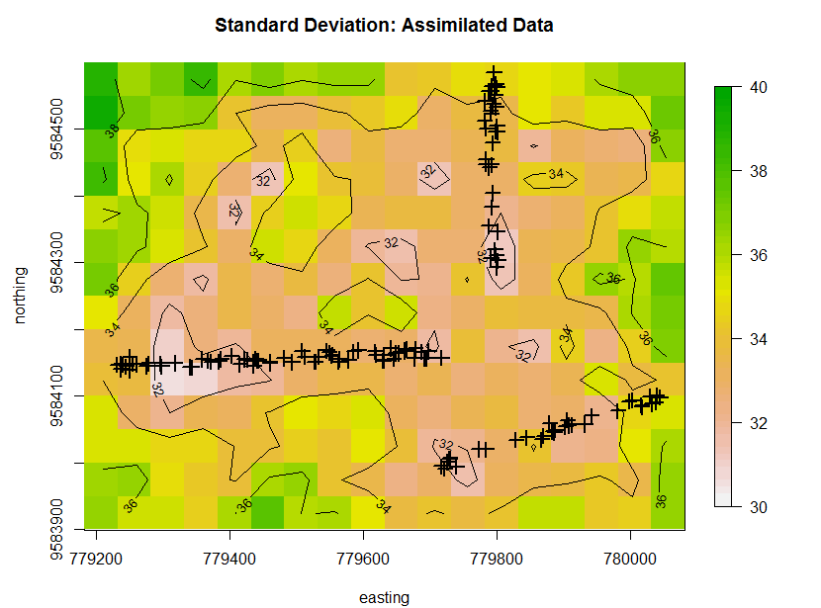
Standard Deviation of
Assimilated ACD Data Product (Mg C ha⁻¹)

Slide 16
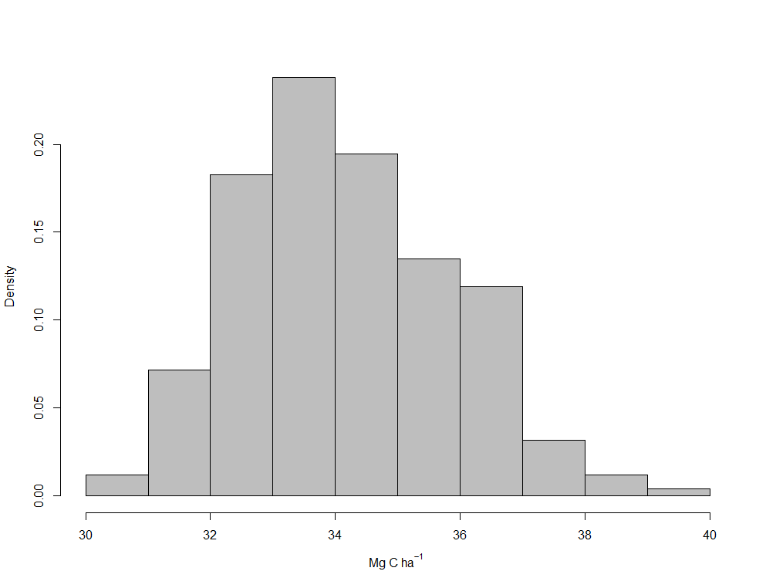
Estimated Standard Deviation of Assimilated Data Product

Slide 17
Limitations
Current approach utilizes uncertainty reducing assumptions
  Lidar component regression of Aboveground Carbon Density ~ height
  Inventory component regression of Aboveground biomass ~ height, dbh, wsd

Slide 18
Next Steps
Account for uncertainty in the parameters in the allometric models
Use analyses of LandSat time series to characterize disturbance
Expand from the test region to the full Municipality of Paragominas

Slide 19





Acknowledgement
Data were acquired by the Sustainable Landscapes Brazil project supported by the Brazilian Agricultural Research Corporation (EMBRAPA), the US Forest Service, and USAID, and the US Department of State.

